Slide 1


Notes:
Minh

Slide 2

r/ Data Preparation
Our Process:
Step 1 - Download and store data in the cloud
Step 2 - Transform / transport data to a place in which
it can be analyzed efficiently ​
Step 3 - Perform analysis and create
relevant visuals ​
Notes:
RILEY

Slide 3

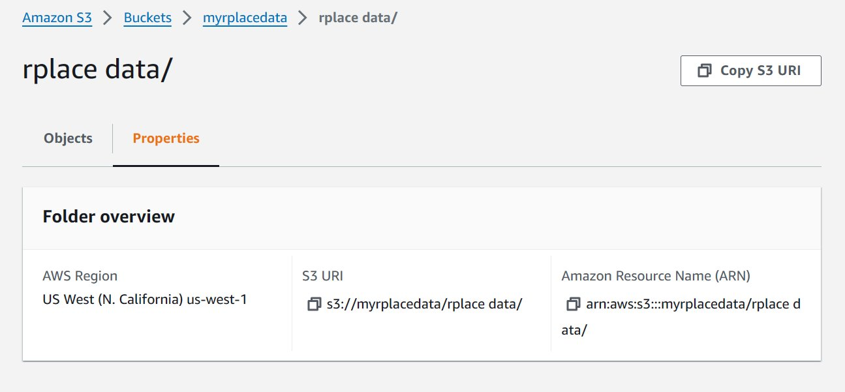
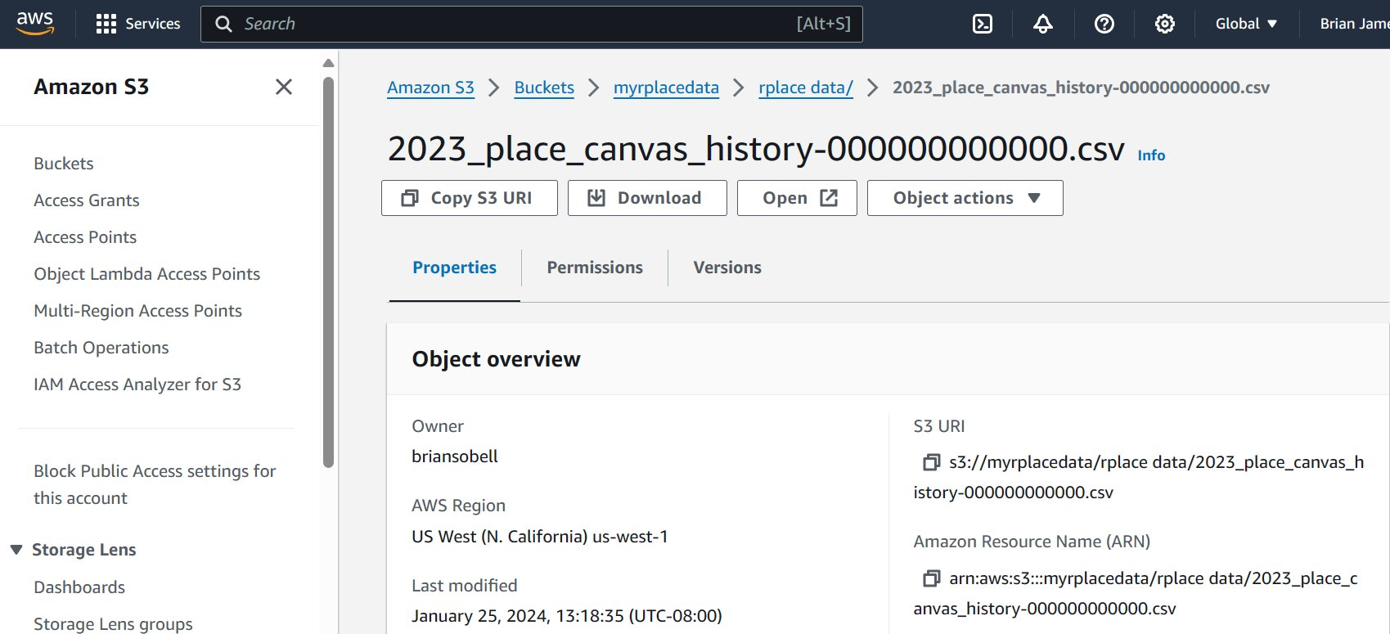
Storing Data in the Cloud:
Amazon S3
* Must select an AWS Region
(keep in mind cost, location)
1
Download the 53 zips, used 7 zip to extract to csv, moved files to a unique folder
2
Upload folder containing all data to an Amazon S3 "Bucket"
Notes:
Brian

Slide 4

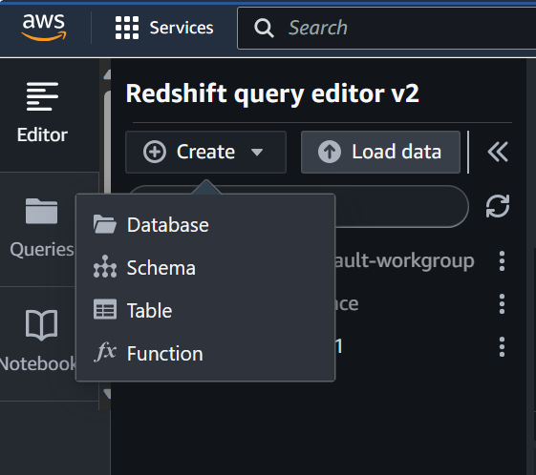
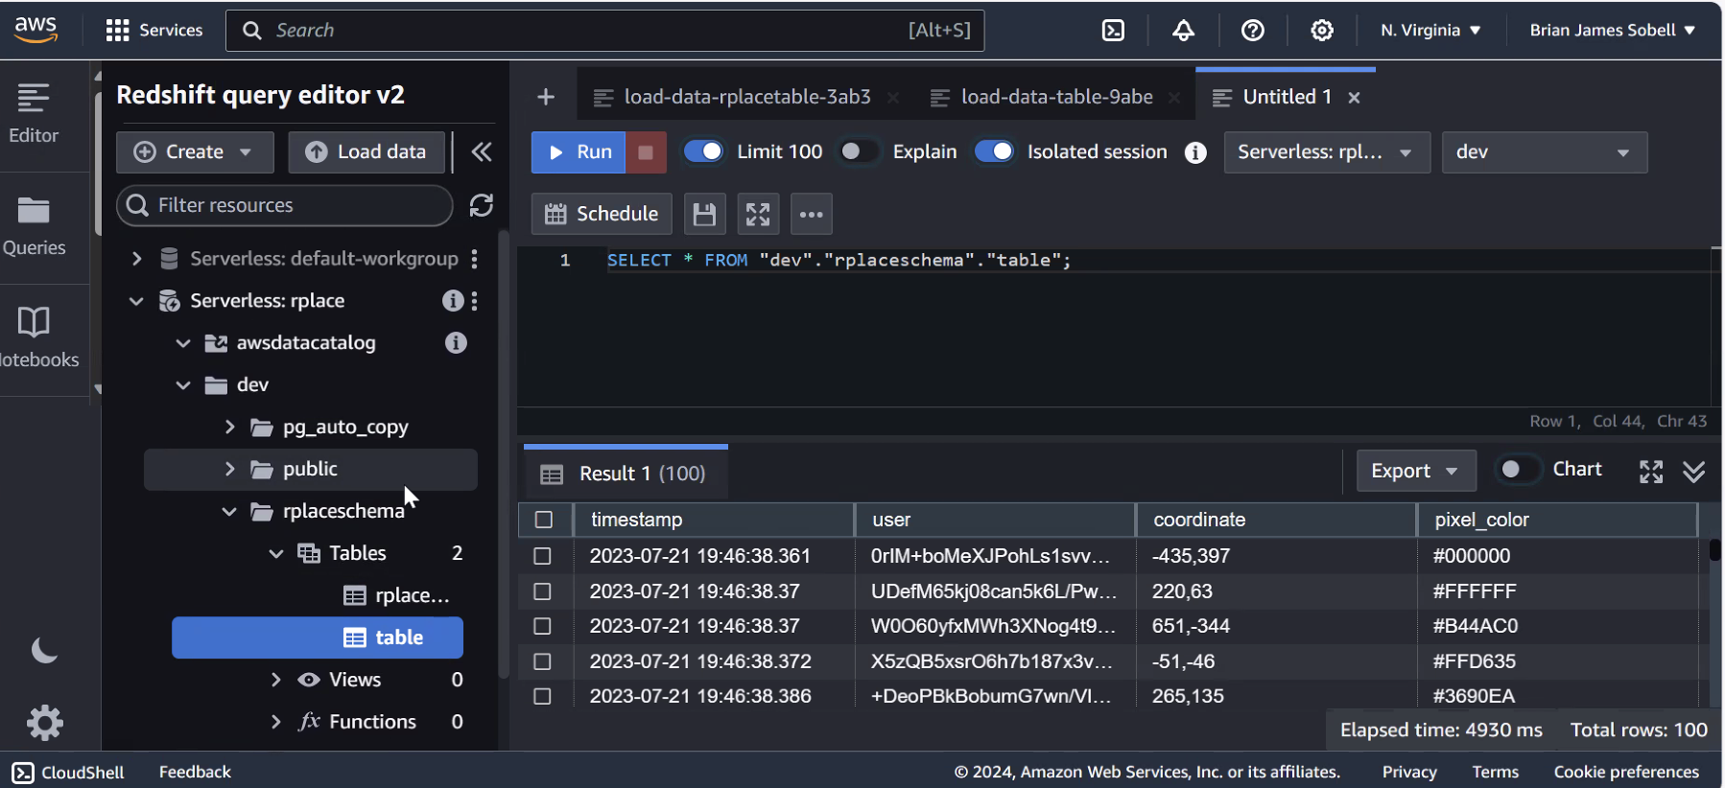
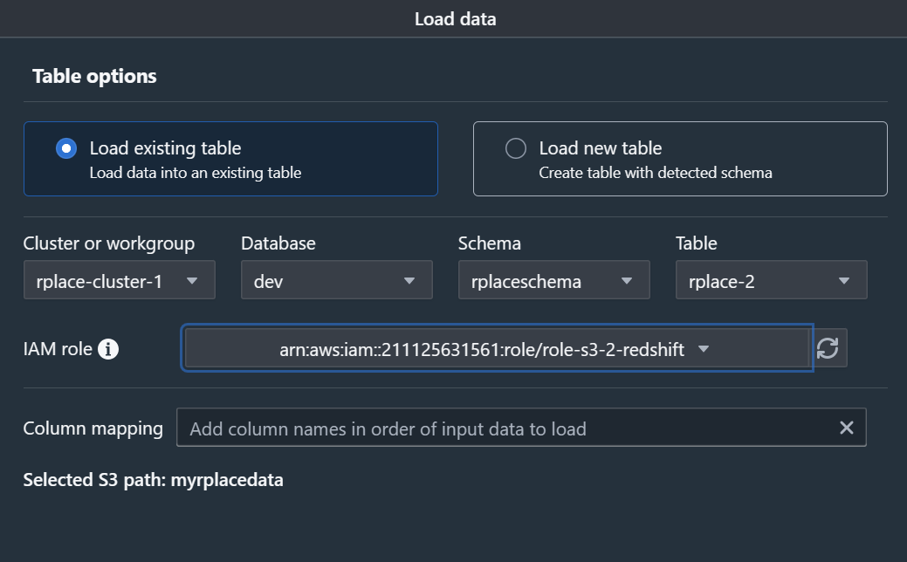
Transporting Data within AWS:
Amazon S3 Amazon Redshift
1
3
2
Notes:
Riley

Slide 5

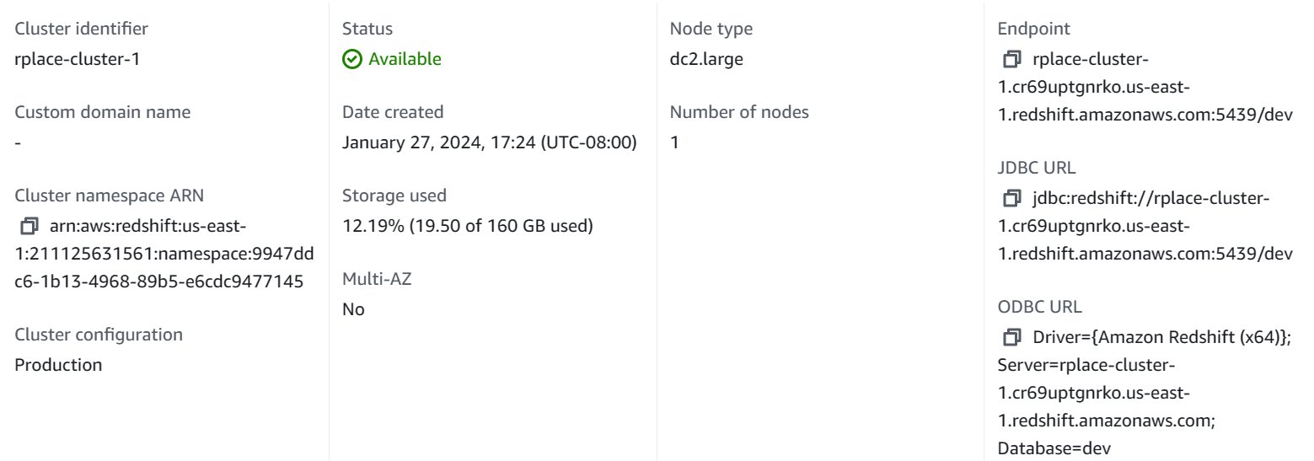
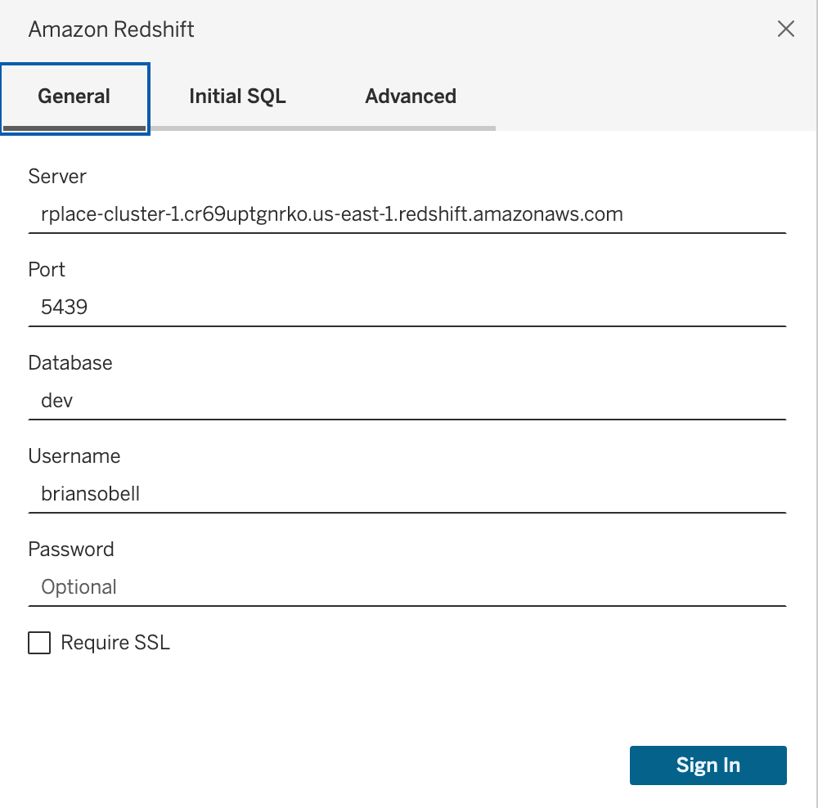



Transporting Data out of AWS:
Amazon Redshift Tableau
Notes:
Kevin

Slide 6
Pixels Contested
Color Distribution
Timeline of Activity
r/ Summary Statistics
We first investigated the data to find interesting insights having to do with Pixels, Colors, and User Activity.
Notes:
Brian

Slide 7
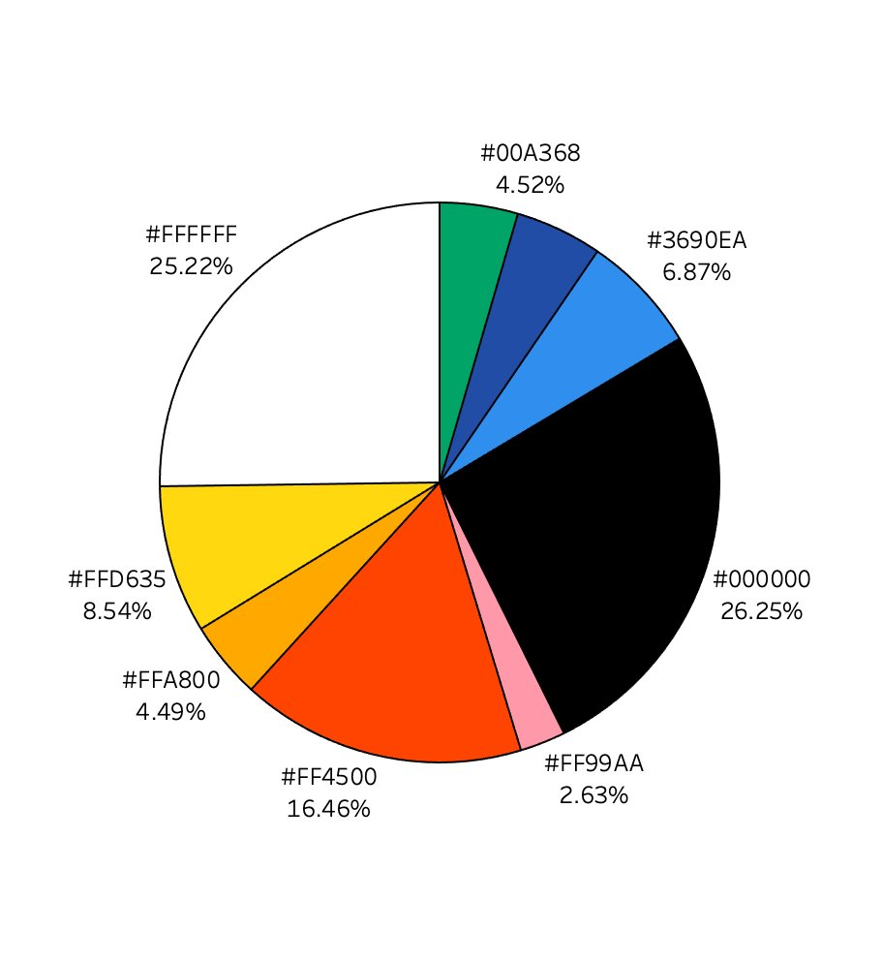
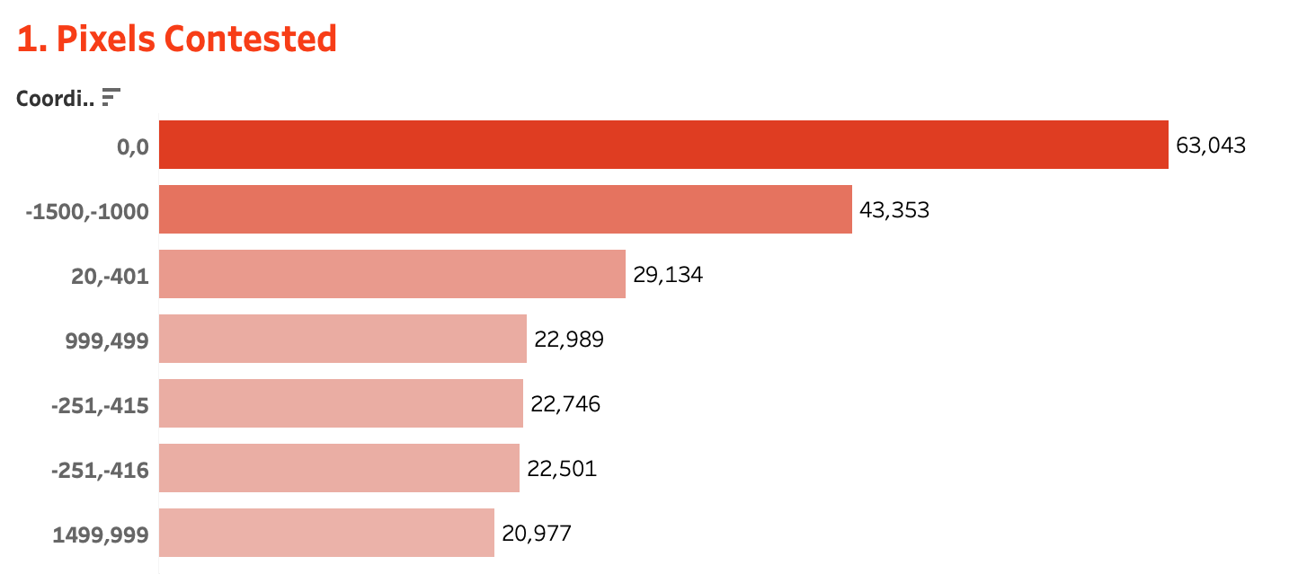
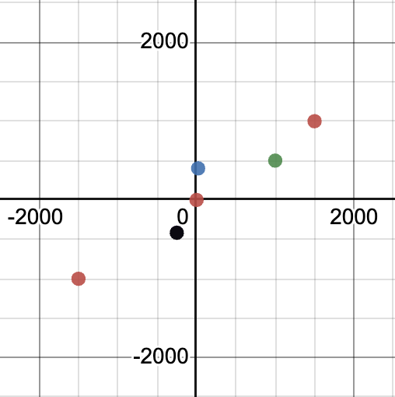
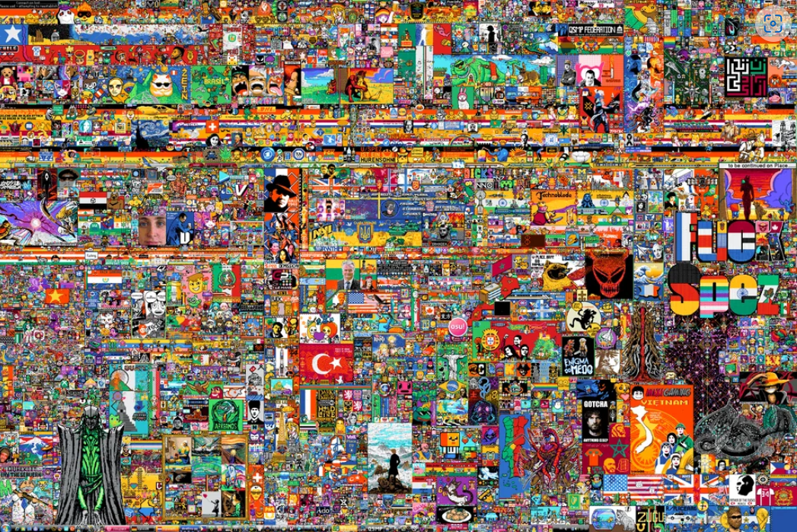
r/ Most Contested Pixel
r/ Top 10 Colors
Notes:
Brian

Slide 8
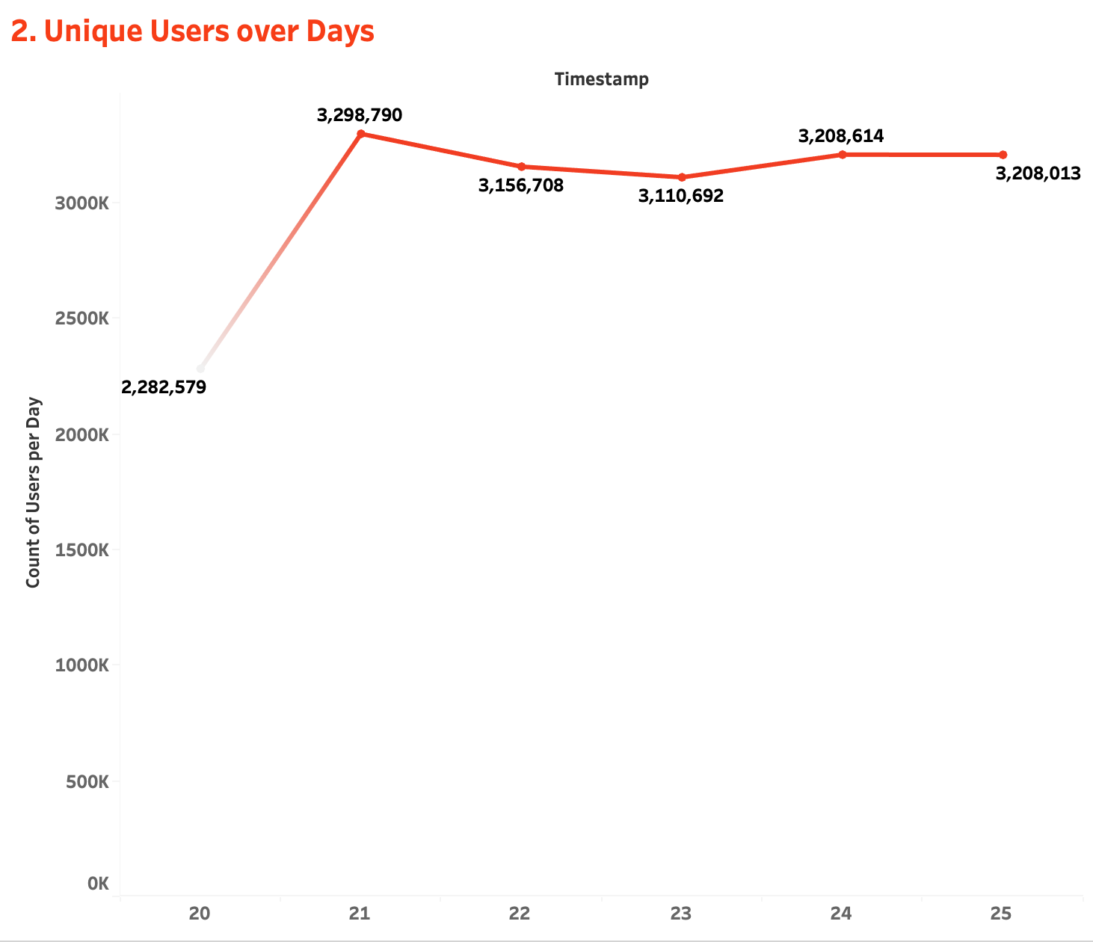
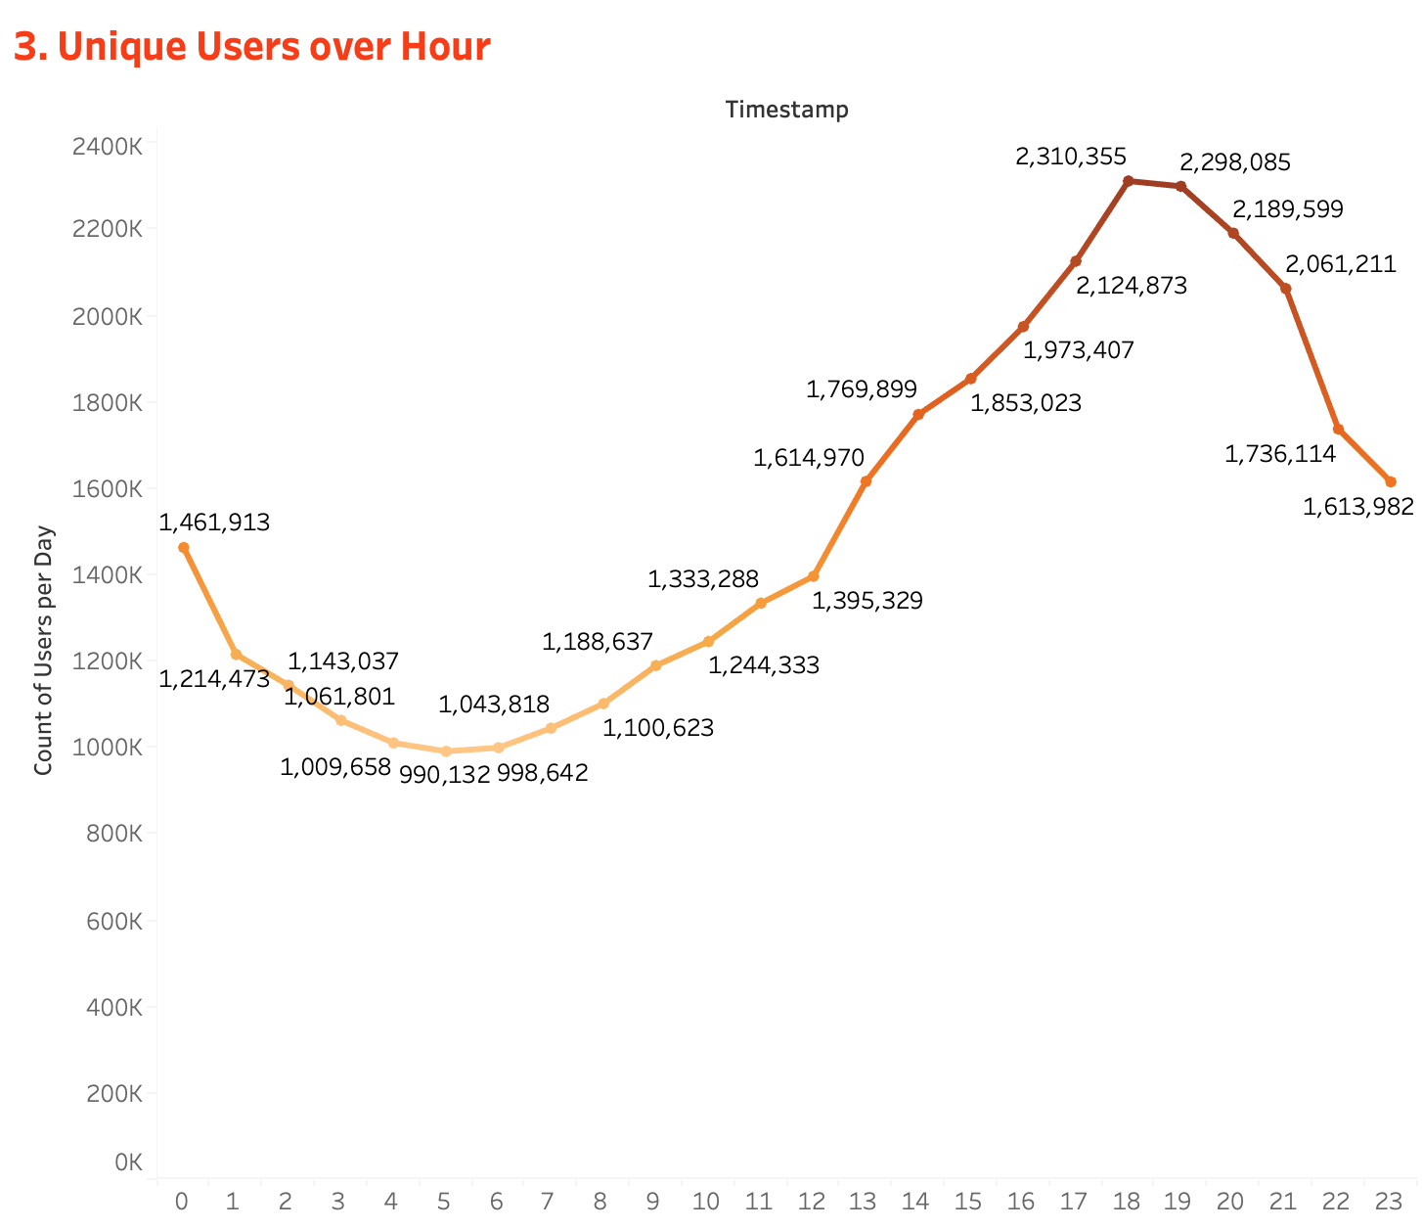
r/ User Activity
8,589,732
Unique Users
r/ Days
r/ Hours
Notes:
Kevin

Slide 9
Unique Users
Pixels Changed per 5 minute
r/ Bot Analysis
We then investigated the data to determine if there are any signs of bot activity.
Notes:
Riley

Slide 10
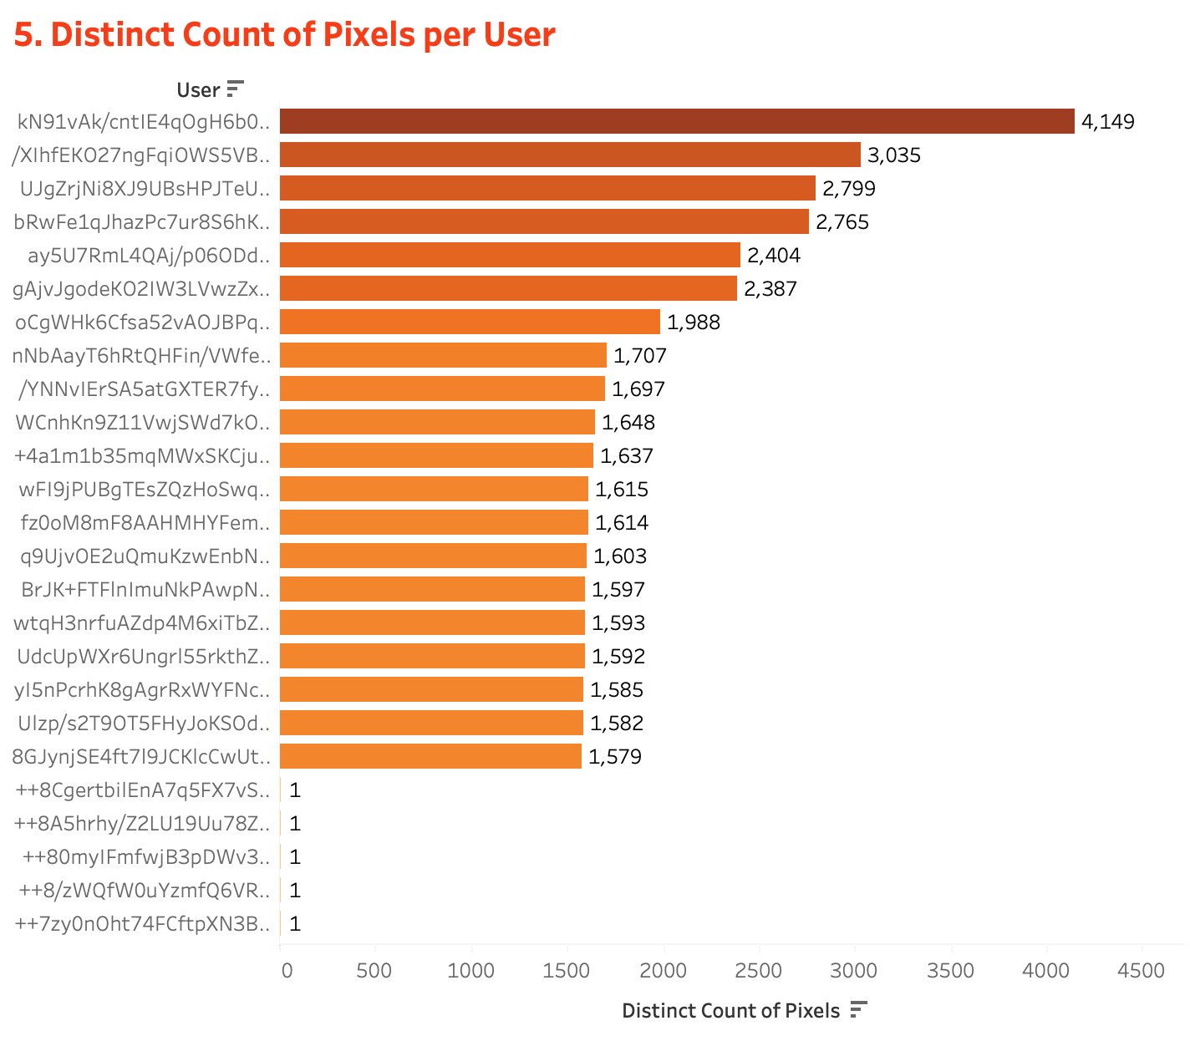
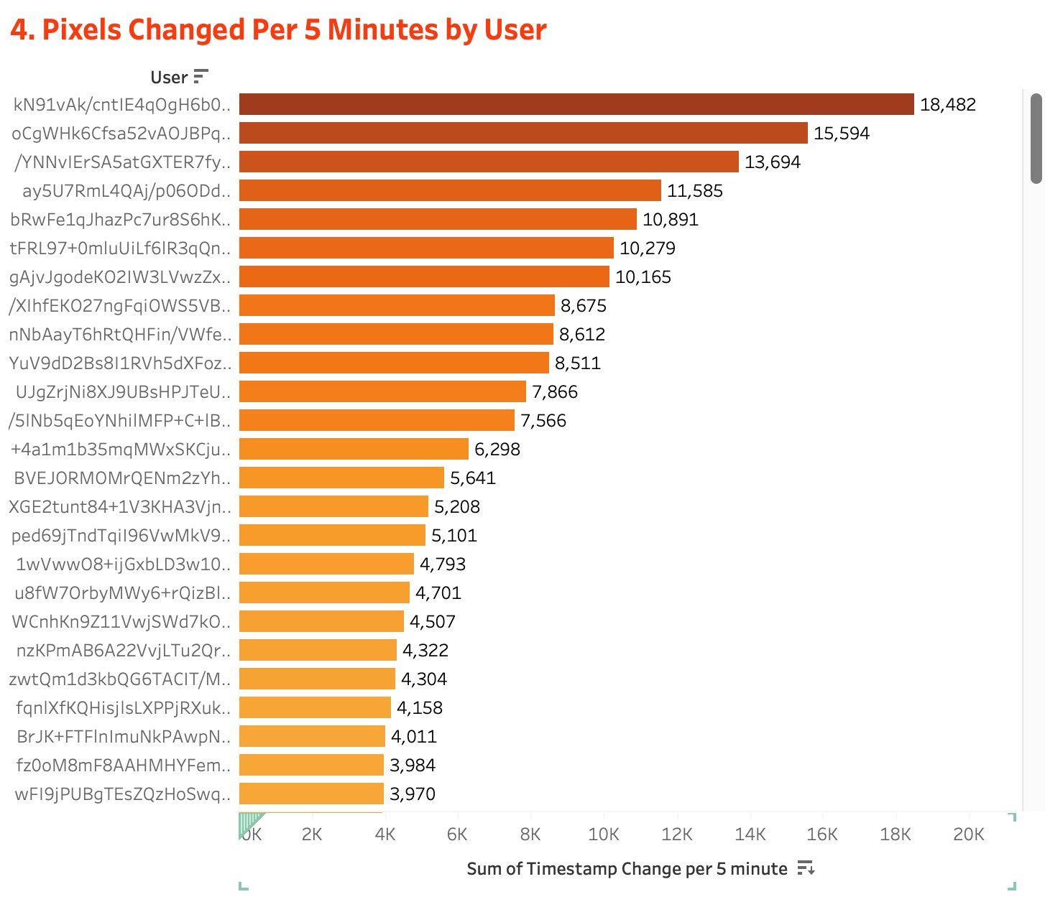
r/ Distinct Counts per User
r/ Bot Detection
Notes:
Minh

Slide 11
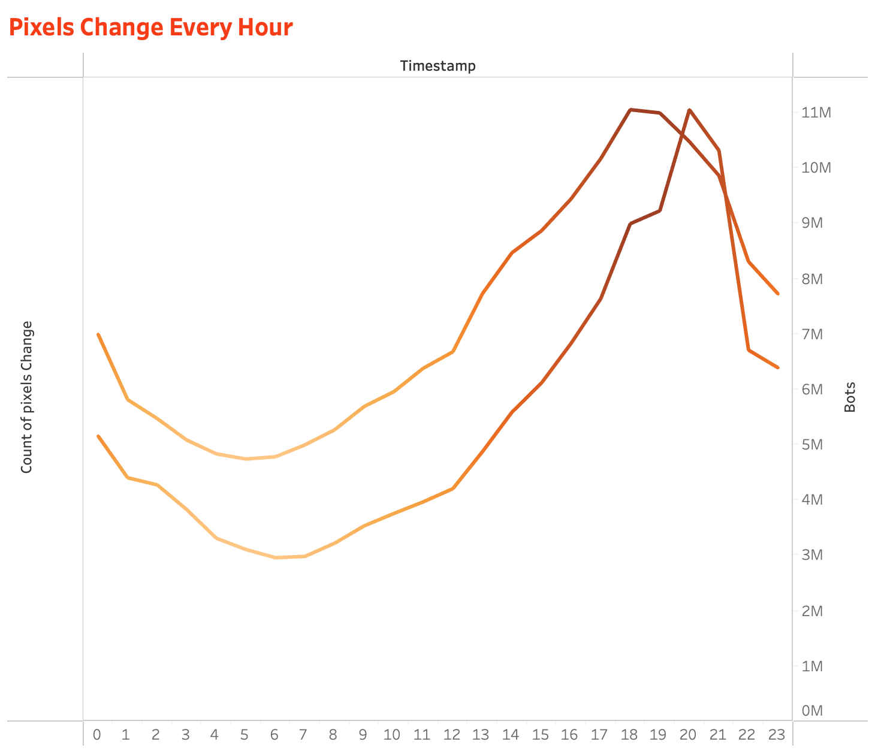
r/ Hourly Pixel Activity (Bots vs Users)
Notes:
Minh

Slide 12
Thank You!

